Slide 1
Global Data Science Challenge
Training session 1 : Data Preparation
Hager Oueslati, Syrine Ben Salah, Victor Azria, Achraf Belmhaidi, Jean-Baptiste Larraufie
Yammer Group: Data Science Challenge

Slide 2
Summary
01
Pattern expression with regular expressions
02
PowerPoint extraction
03
Text Pre-Processing
04
Web Scrapping
05
Any questions ?
www.referencia.com
© 2017 Capgemini. All rights reserved.
2
Notes:
Este slide eles acham que esta muito apertado.
Mudar o estilo do texto do lado esquerdo para diferencia-lo do texto do lado direito. Menos texto e mais impactante “short introduction”. Coloccar este texto do lado esquerdo da mesma cor da forma e o fundo do dlide claro.

Slide 3
01
Pattern extraction with Regular Expressions
A Regular Expressions (Regex) is a string using a particular syntax that describes an ensemble of different strings.
E.g.: [\w+.-]+@[\w.-]+\.[a-zA-Z]{2,} describes the pattern of an email address.
>>> import re
>>> re.findall("([0-9]+)", "Hello 111 World 222")
['111', '222']
Regex | Pattern
data | Matches the strings ‘data’ in the text
^Data | Matches the string ‘Data’ in the beginning of the text
data$ | Matches the string ‘data’ in the end of the text
Data|data | Matches the strings ‘data’ and ‘Data’ in the text

Slide 4
01
Pattern extraction with Regular Expressions
Regex | Pattern
[abc] | Ensemble : matches with the string ‘a’, ‘b’ or ‘c’ in the text
dat[ae] | Matches with ‘data’ and ‘date’
[a-z] | [abcdefghijklmonpqrstuvwxyz]
[A-Z] | [ABCDEFGHIJKLMNOPQRSTUVWXYZ]
[0-9] | [0123456789]
[a-z0-9] | [abcdefghijklmonpqrstuvwxyz0123456789]
. | Any character (Warning : \. matches only with .)
\w | [a-zA-Z0-9]
\d | [0-9]
\n | Return
\t | Tab

Slide 5
01
Pattern extraction with Regular Expressions
Regex | Pattern
re* | Matches 0 or more occurrences of preceding expression.
re+ | Matches 1 or more occurrence of preceding expression.
re? | Matches 0 or 1 occurrence of preceding expression.
re{n} | Matches exactly n number of occurrences of preceding expression.
re{n,} | Matches n or more occurrences of preceding expression.
Hint : use https://regex101.com/ to help you write your Regex !

Slide 6
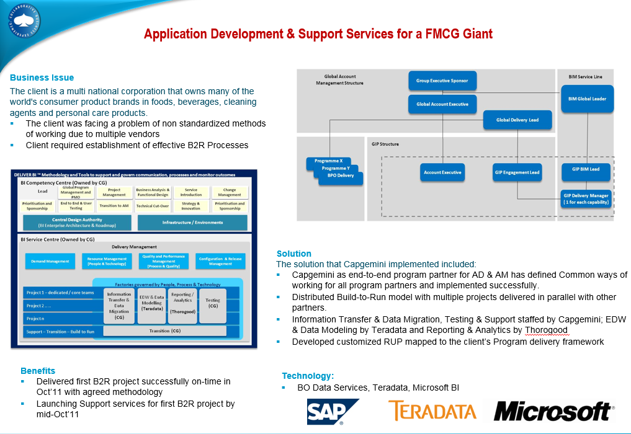
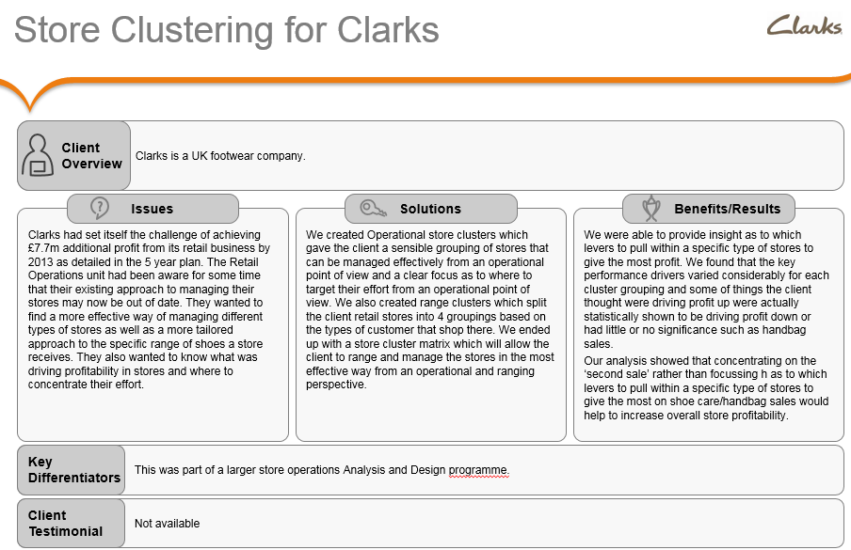
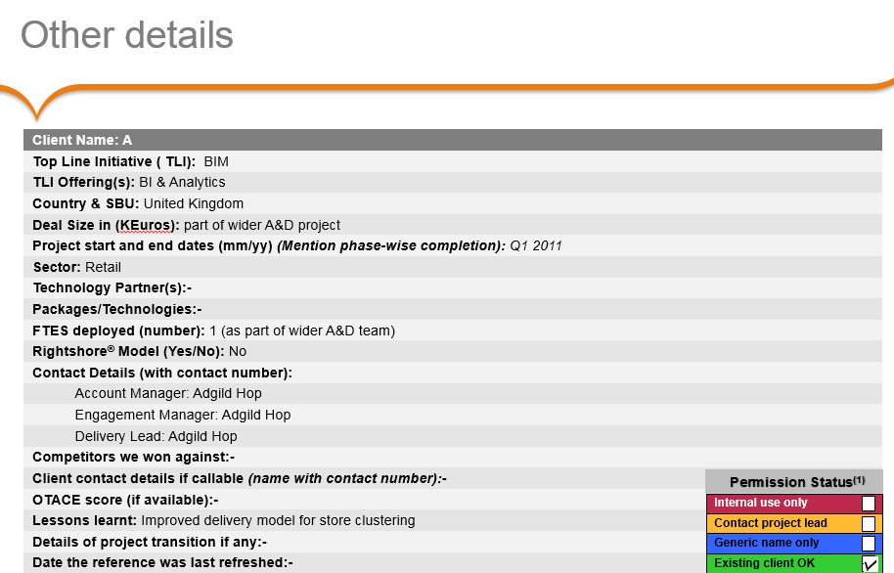
02
PowerPoint Extraction
Data type : Commercial propositions in Powerpoint format (.ppt/.pptx)
The goal : Extract important informations from Powerpoint files
Example of commercial proposition files :

Slide 7
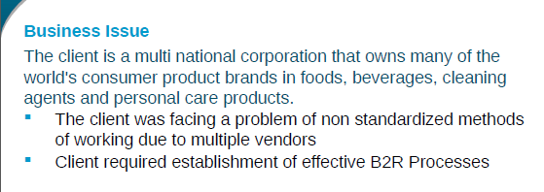
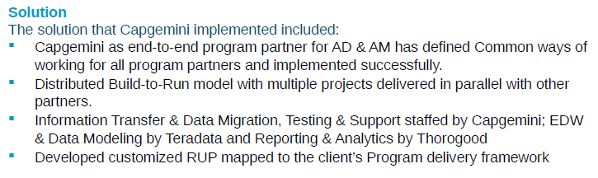
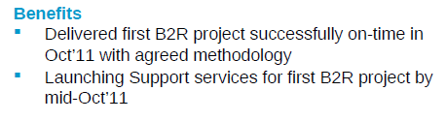
02
First method using python-pptx library
python-pptx: read each seperate box in the slide as « Shape » type.
Shape type offers functions to read a text or a table
Shape 1
Shape 2
Limitation : When boxes are groupes, these functions return nothing
Shape 3

Slide 8


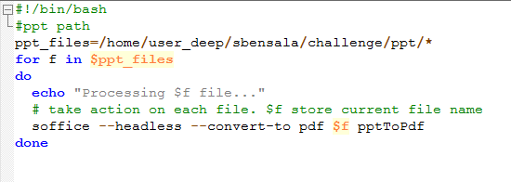
02
Second Method using textract python library
1- Convert ppt files to pdf using the libreOffice command line « soffice », through a shell script 2- Extract text from the pdf files, using the python library textract
Shell script
Put generated pdf files in the current directory

Slide 9
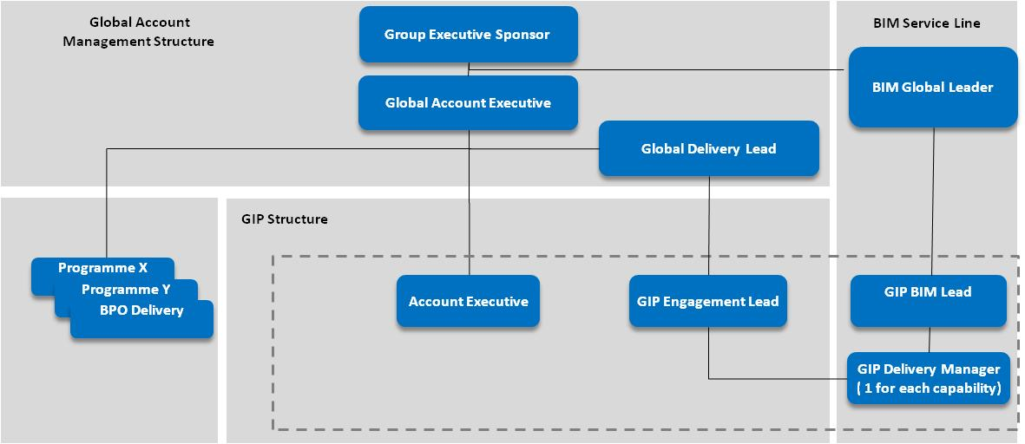
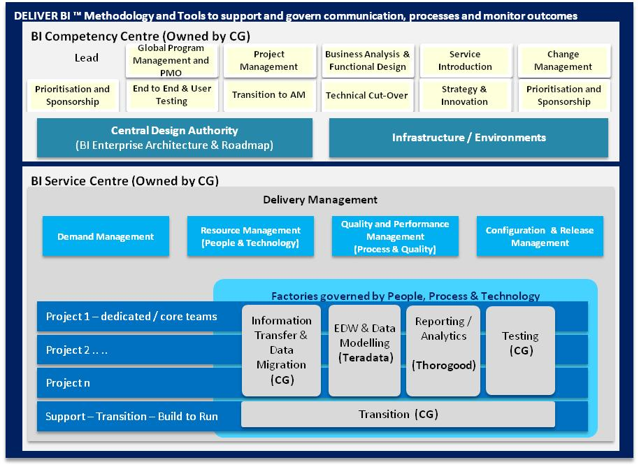



Application Development & Support Services for a FMCG Giant
02
Business Issue
The client is a multi national corporation that owns many of the world's consumer product brands in foods, beverages, cleaning agents and personal care products.
The client was facing a problem of non standardized methods of working due to multiple vendors
Client required establishment of effective B2R Processes
Solution
The solution that Capgemini implemented included:
Capgemini as end-to-end program partner for AD & AM has defined Common ways of working for all program partners and implemented successfully.
Distributed Build-to-Run model with multiple projects delivered in parallel with other partners.
Information Transfer & Data Migration, Testing & Support staffed by Capgemini; EDW & Data Modeling by Teradata and Reporting & Analytics by Thorogood
Developed customized RUP mapped to the client’s Program delivery framework
Benefits
Delivered first B2R project successfully on-time in Oct’11 with agreed methodology
Launching Support services for first B2R project by mid-Oct’11
Technology:
BO Data Services, Teradata, Microsoft BI
Notes:
Unilever

Slide 10
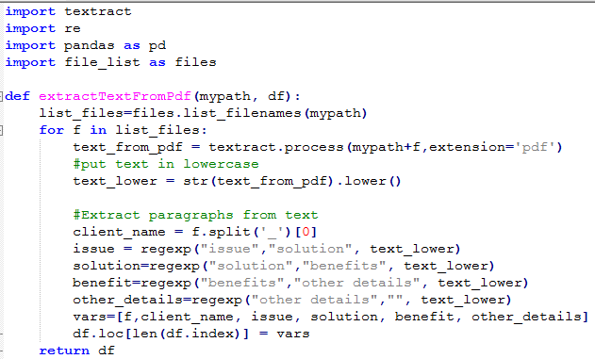
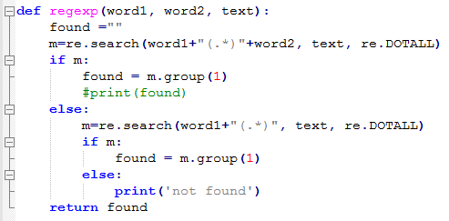
02
Second Method using textract python library
pdf_title | Client_name | Issue | Solution | Benefit

Slide 11
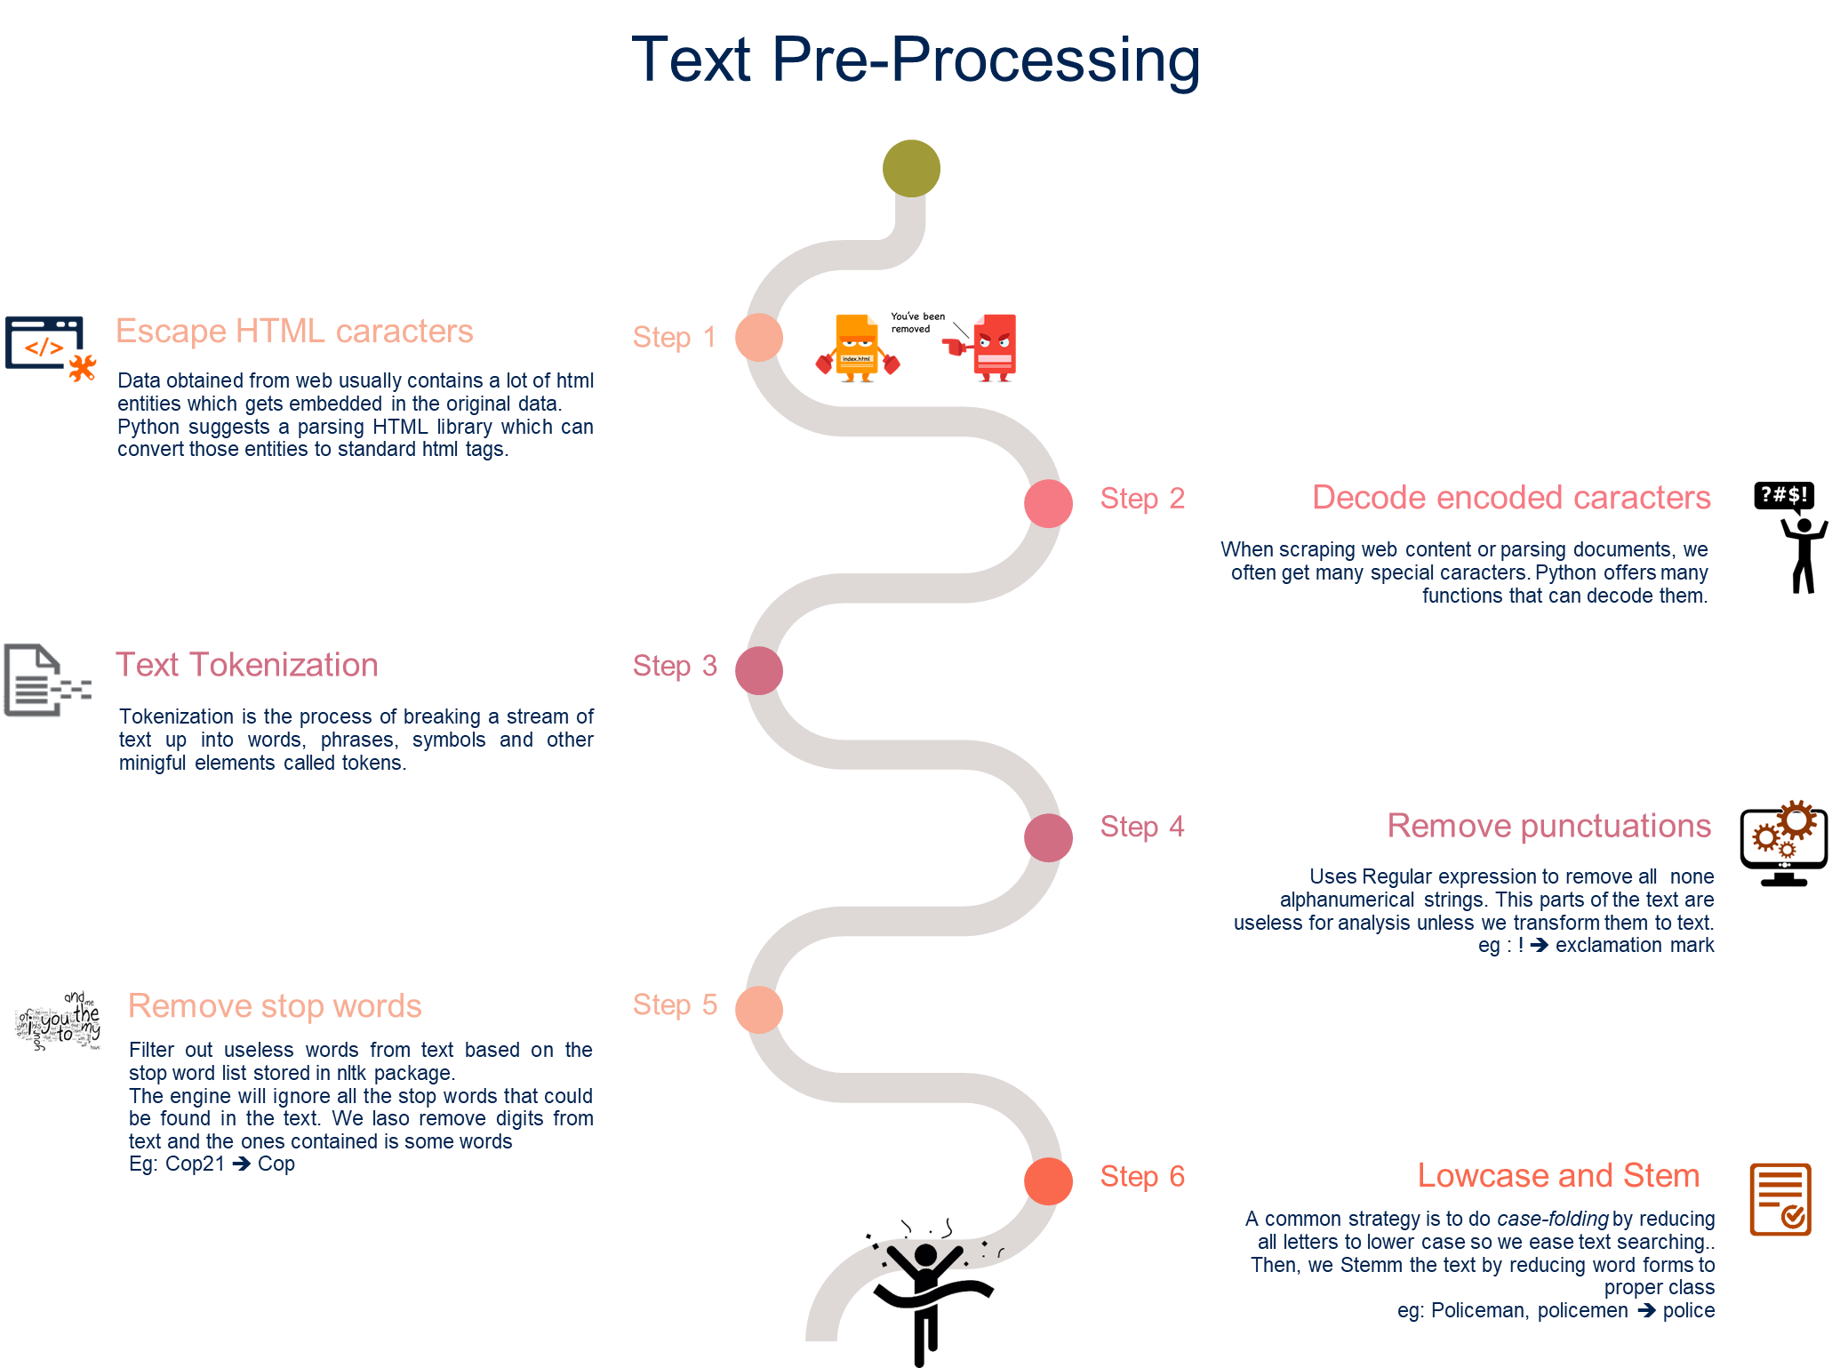
03
Text Pre-Processing

Slide 12
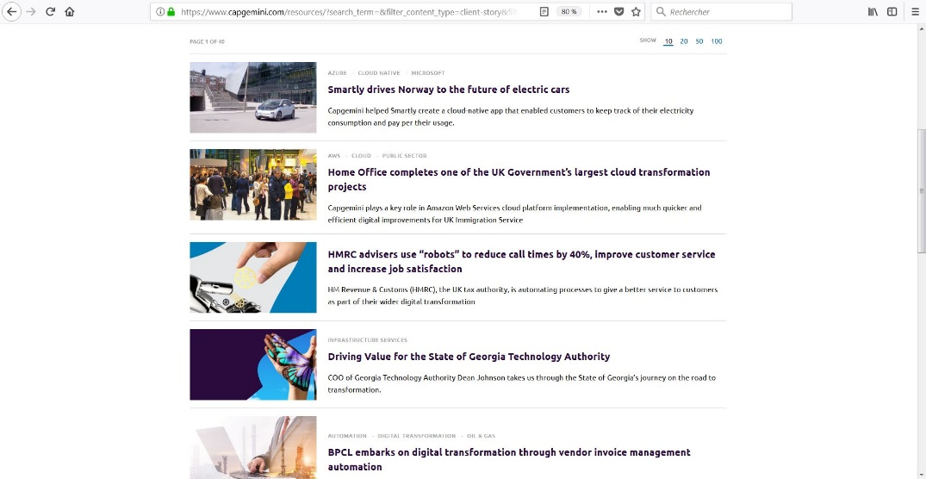
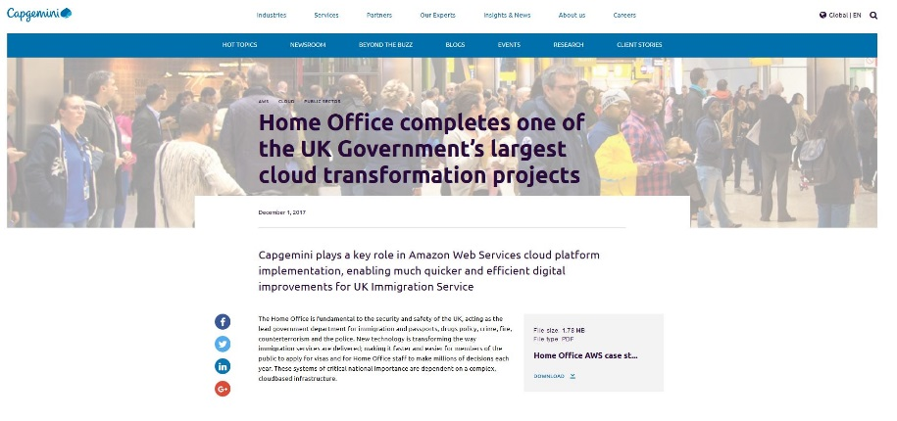
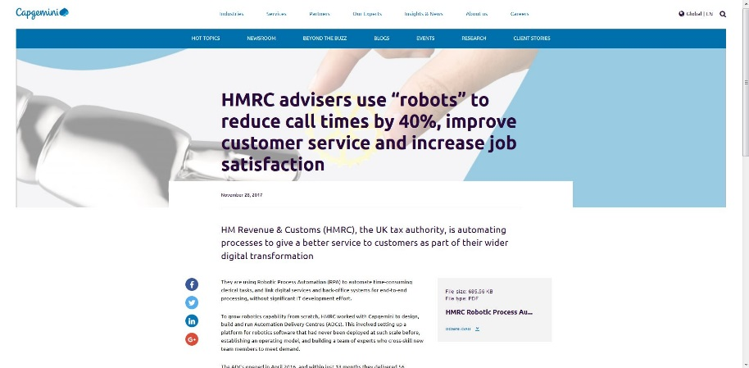
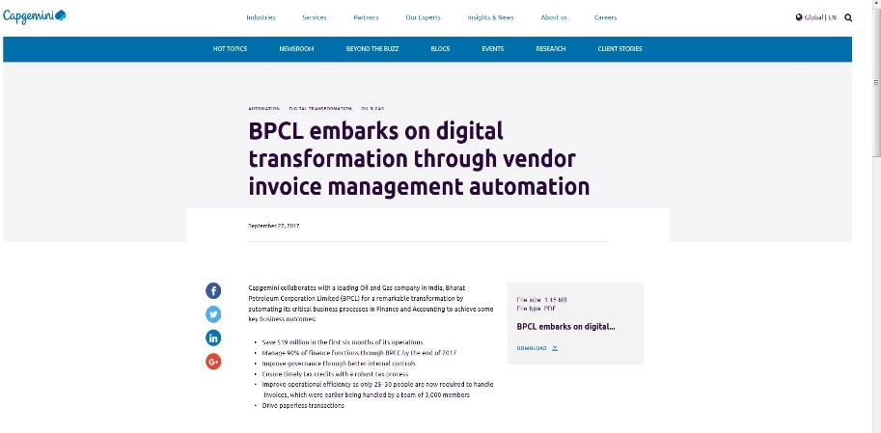
Web Scrapping : Construct a database
04
While visiting Capgemini website, we found some references of the group around the world. We’ve decided to scrap all of theses references into a database containing title, date, abstract, tags, text content/description and external content (PDF).
Title | Abstract | Date | Text | Tags | External content
Story
Scrap and insert into database

Slide 13
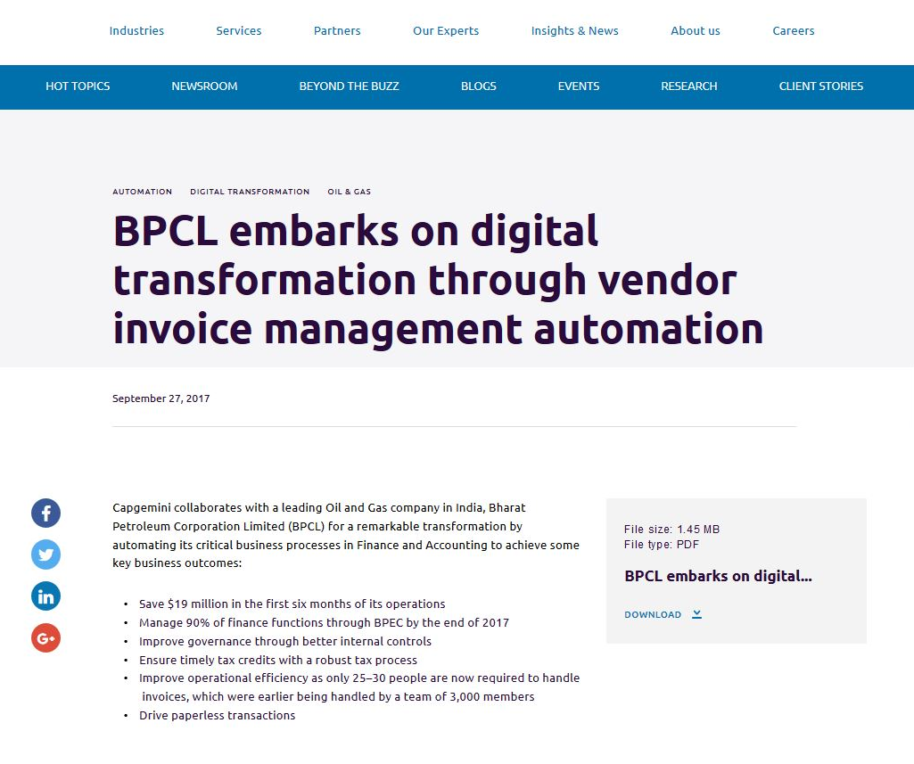
04
Web Scrapping : Identify tags on the source code
Right-click on the webpage in order to print the source code. Search in and identify all the tags which contain your data. This step will permit you to construct your template of pyhon scrapper code.
<div class="component__hero-subpage__tags">
<span>automation</span>
<span>Digital Transformation</span>
<span>Oil &amp; Gas</span>
</div>
<h1 class="component__hero-subpage__title">BPCL embarks on digital transformation through vendor invoice management automation</h1>
<span>September 27, 2017</span>
<div class="article-text">
<p>Capgemini collaborates (…) </p>
</div>
<div class="card__newsroom__download">
<a href="https://www.capgemini.com/wp-content/uploads/2017/09/bpcl-embarks-on-digital-transformation-through-vendor-invoice-management-automation.pdf" aria-label="Download">Download</a>
</div>
Hint : Use Mozilla Firefox which dispose powerfull tools to examine source code

Slide 14
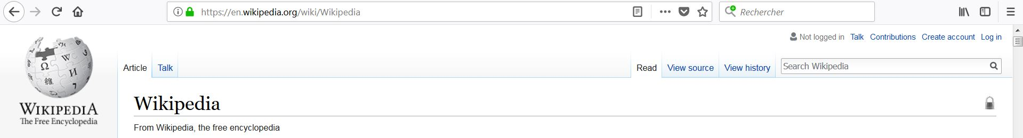
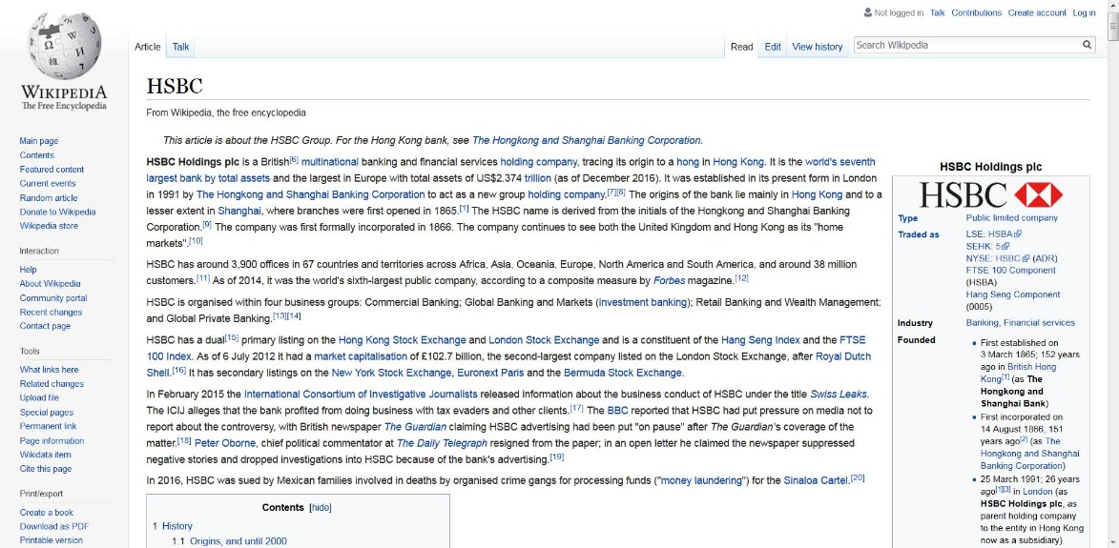
Web Scrapping : Enrich your database
04
Using Regex techniques previously exposed, you will be able to successfully extract the names of clients in the reference database. The idea is to merge thi database with additional data, provided by the “Web Scrapping” method applied on Wikipedia using the searchbar with the name of each company on it and then recover the results.
Pass a list of companies in argument of the searchbar.
Example: [HSBC,Total,Amazon]
Use Case
Scrap the data and output it on a new database.
Company | Text

Slide 15

Any questions ?
05
Do not hesitate to contact us:
Text Pre-Processing : hager.oueslati@capgemini.com
Regex : victor.azria@capgemini.com
PowerPoint Extraction : syrine.ben-salah@capgemini.com
Web Scrapping : achraf.belmhaidi@capgemini.com / jean-baptiste.larraufie@capgemini.com
You can open or react on a Yammer topic too ! Good luck for data preparation!
Presentation Title | Author | Date
Notes:
A forma SEMPRE tem que ter ponta!

